Slide 1
Part 1: Batching or GPU Sharing?
Tao Li
[1] Faster Transformer. https://github.com/NVIDIA/ FasterTransformer.
[2] Orca: A distributed serving system for Transformer-Based generative models. OSDI’22
[3] vLLM: Efficient memory management for large language model serving with pagedattention. SOSP ’23
[4] Sarathi-Serve: Taming Throughput-Latency Tradeoff in LLM Inference with Sarathi-Serve. OSDI’24
Notes:
1. 我们现在考虑的场景是云上多模型多租户的大模型推理，我们认为GPU sharing是支持这种场景的关键技术，我们之前也讲了一些GPU sharing的技术，因为我们想基于Serverless computing的云环境去做，因此我们最近看了些在容器云上优化GPU sharing的一些工作，今天给两位老师进行一下汇报，结合上次老师们建议我们这次的内容会多一些如何使用GPU等系统实现上的内容。

Slide 2
Batching
FasterTransfomer^{[1]}
vLLM^{[2]}
Orca^{[3]}
Srarathi-Serve^{[4]}
[1] Faster Transformer. https://github.com/NVIDIA/FasterTransformer.
[2] vLLM: Efficient memory management for large language model serving with pagedattention. SOSP ’23
[3] Orca: A distributed serving system for Transformer-Based generative models. OSDI’22
[4] Sarathi-Serve: Taming Throughput-Latency Tradeoff in LLM Inference with Sarathi-Serve. OSDI’24

Slide 3
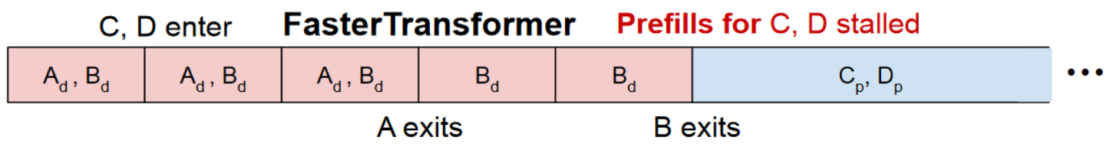
FasterTransfomer
Request-level batching
A new batch runs only after all requests in the current batch completes
Example
Requests C and D enter during the decode phase of requests A and B
Pros and cons
C,D don’t affect the decode of A,B, but prefill for C,D stalled
Timeline
[1] Faster Transformer. https://github.com/NVIDIA/FasterTransformer.

Slide 4
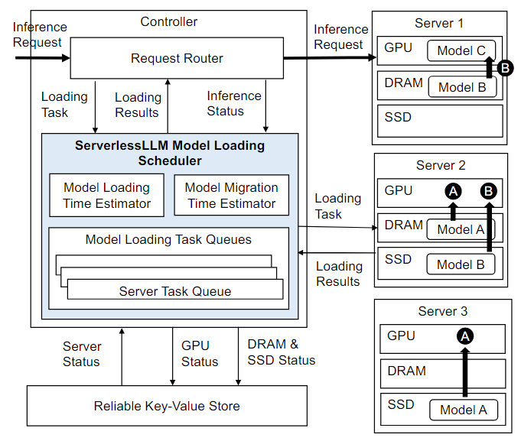
Motivation
Current challenges of serverless inference
Downloading and loading LLMs causes high latency
LLM serving needs to meet SLO requirements
ServerlessLLM^{[1]}
mitigate inference delays
Utilize multi-tier storage to accelerate model loading
Live migration for LLM inference
[1] ServerlessLLM: Low-Latency Serverless Inference for Large Language Models. OSDI’24

Slide 5
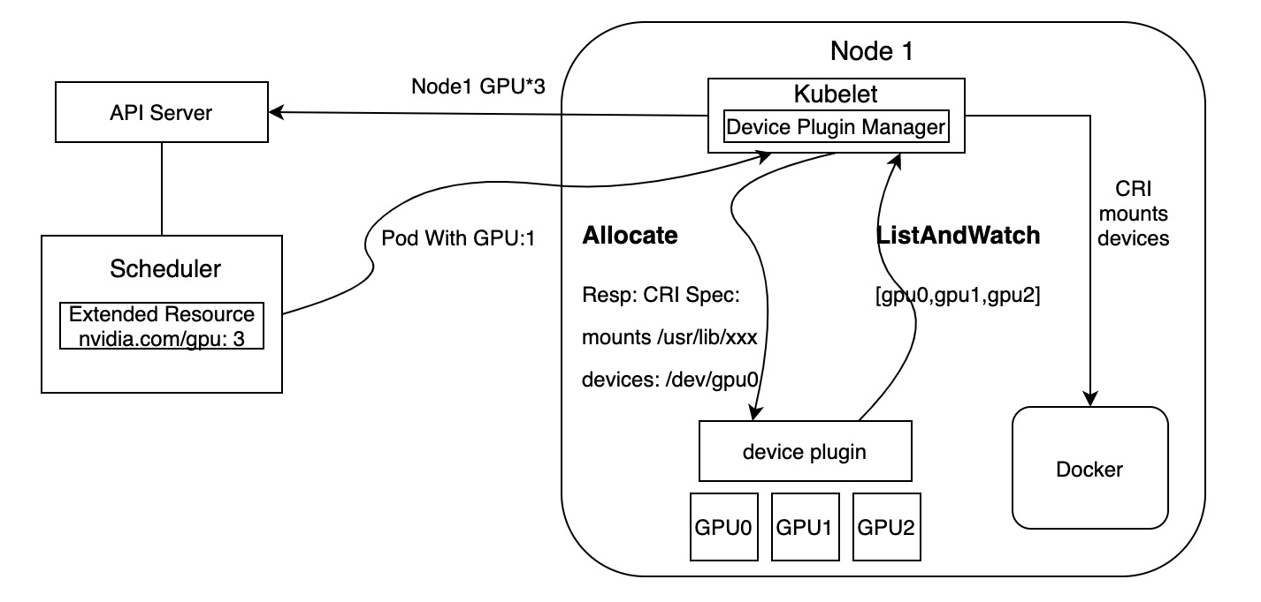
Design
How to further improve LLM inference throughput?
GPU sharing
Timeslicing
Multi-Instance GPU (MIG)
Multi-Process Service (MPS)
Device plugin

